Slide 1
Minimizing Disk I/O in Dynamic ALSD
Abu Ayub Ansari Syed, Zaid Bin Irfan
University of Texas at Arlington
Email: abuayubansari.syed@mavs.uta.edu
zaidbin.Irfan@mavs.uta.edu

Slide 2
References
Ongoing research project of Mr. Soumyava Das.

Slide 3
Acknowledgments
Soumyava Das, PhD Student ITLAB, UTA.

Slide 4
Problem statement
Using distributed framework (map/reduce), for finding the substructure that can compress the graph best in a very large directed labeled graph, we need to identify repetitive subgraphs that satisfy certain characteristics.
Understand how much a partition contributes towards update of Adjacency List.
Understand trend of contribution across iterations.
Identifying better partitioning strategies using above understanding.

Slide 5
Why do you think this problem is interesting/important
It can minimize Disk I/O.
Can result in huge performance enhancement.
Determine better Partitioning Algorithm.

Slide 6
Approach and why it is appropriate
Determine the maximum number of Partition loads in each of the iterations of the Reducers.
Determine the minimum number of Partition loads actually required by the Reducers.
Determine overlapping partitions.
Using above methods, we can identify pattern of how Number of Loads vary with Number of Iterations.

Slide 7
Approach
Initially we partition the graph, and create its adjacency list.
We find the common substructure after every iteration from each reducer.
We find all the vertex required to update the adjacency list. We also find how many of these vertex could be found in other partitions.
We find contribution of each partition if they were loaded sequentially, or the contribution if they were loaded individually.

Slide 8
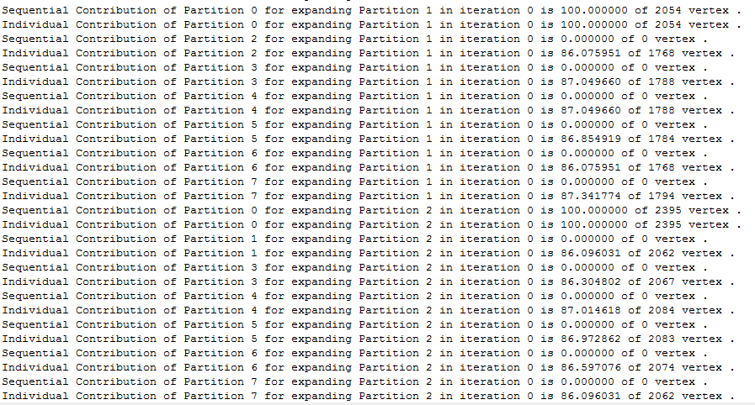
Sample Output

Slide 9
Data sets and why you have chosen that
Large Dense Graphs. Ex. With 800,000 edges.
Partitioned Data as a result of different Partitioning Algorithms. Ex. Arbitrary Partitioning, METIS.

Slide 10
Outcome of this project
Analysis on effect of Partitioning Algorithms on Graph Mining.
Analysis of Minimizing Disk I/O in Graph Mining.

Slide 11
Do you think there is a paper in this work?
This is a new experiment in this direction.
It is based on the ongoing research of Mr. Soumyava Das.

Slide 12
Project Details
What have you done so far?
Coding - 100%
Understanding of data - 100%
Test runs - 100%
Sanity check
How have you approached the project?
Understanding of the solution
Soumyava Das has explained this very clearly.
Your timeline for completing the project
On time, we will submit code by 6th May.

Slide 13
Other details
What system are you using?
Windows, Java.
Why did you choose this?
Feasible option
What have you gained from this project?
Better understanding of graph mining.
Analytical study of patterns in the Graph Mining.

Slide 14

Thank You !!!

